Slide 1
Analysis of school performance
Bailey High School
Cabrera High School
Figueroa High School
Ford High School
Griffin High School
Hernandez High School
Holden High School
Huang High School
Johnson High School
Pena High School
Rodriguez High School
Week 4
Rong GUO

Slide 2
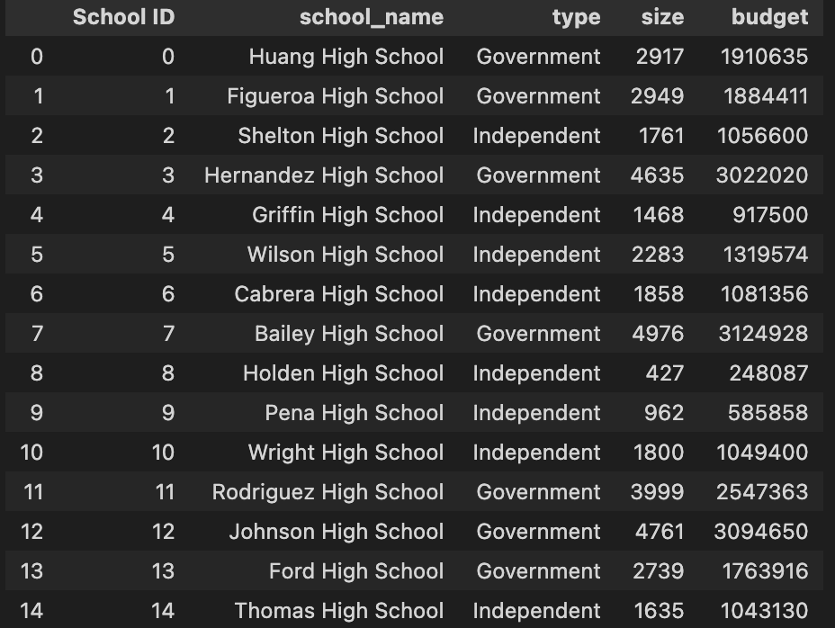
1.1
Local Government Area (LGA) Summary
Total number of unique schools: 15 schools in total.
School type: 7 Government and 8 Independent.
Total students: 39,170.
Total budget: $ 24,649,428.

Slide 3
1.2
Local Government Area (LGA) Summary
Average maths score: 70.34
Average reading score: 69.98
% passing maths: 86.08%
% passing reading: 84.43%
% passing both Maths &
Reading: 72.81%
*Note: A passing grade is 50 or higher.

Slide 4
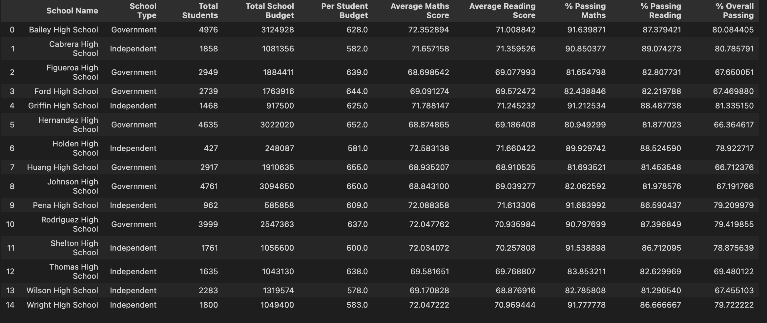
2.1
School Summary

Slide 5
Highest Performance
2.2
Griffin High School
(independent)
School Summary
Top 5
Performing
Schools
2. Cabrera High School
(independent)
3. Bailey High School
(government)
(By % Overall Passing)
4. Wright High School
(independent)
5. Rodriguez High School
(government)

Slide 6
2.3
11. Griffin High School
(government)
Bottom 5
Performing
Schools
School Summary
12. Huang High School (government)
(By % Overall Passing)
13. Johnson High School
(government)
14. Wilson High School
(independent)
15. Ford High School
(government)
Lowest Performance

Slide 7
2.4
For Per student budget, ”Huang High School (Government)” is the highest, while the lowest is “Wilson High School (independent)”.
“Holden High School (independent)”, their students performed the best in both average Maths and Reading, got average Maths score is 72.58 and average Reading scores is 71.66.
For the passing Maths, “Wright High School (independent)” is greatest 91.78% while “Hernandez High School (Government)” is the worst with 80.95%.
For the passing Reading, “Cabrera High School (independent)” is greatest 89.07% while “Wilson High School” is the worst with 81.3%.
School Summary

Slide 8
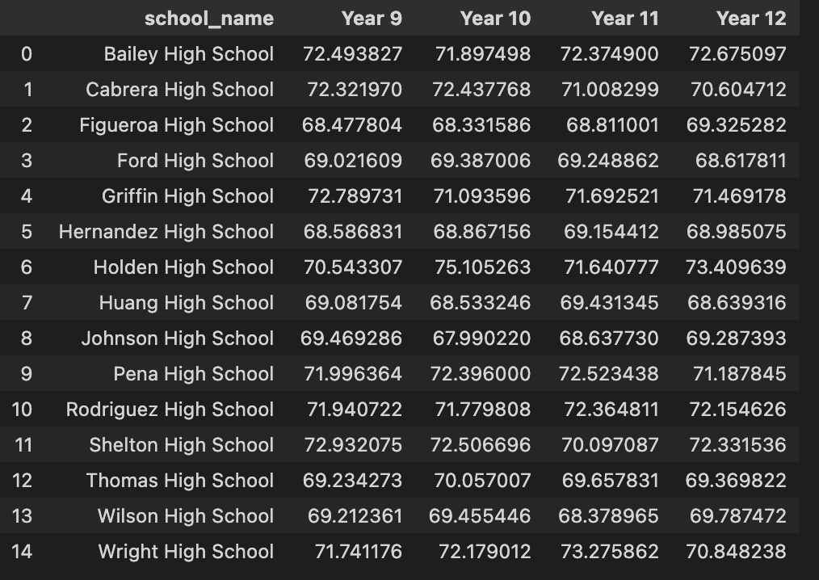
3.1
Maths Scores by Year

Slide 9
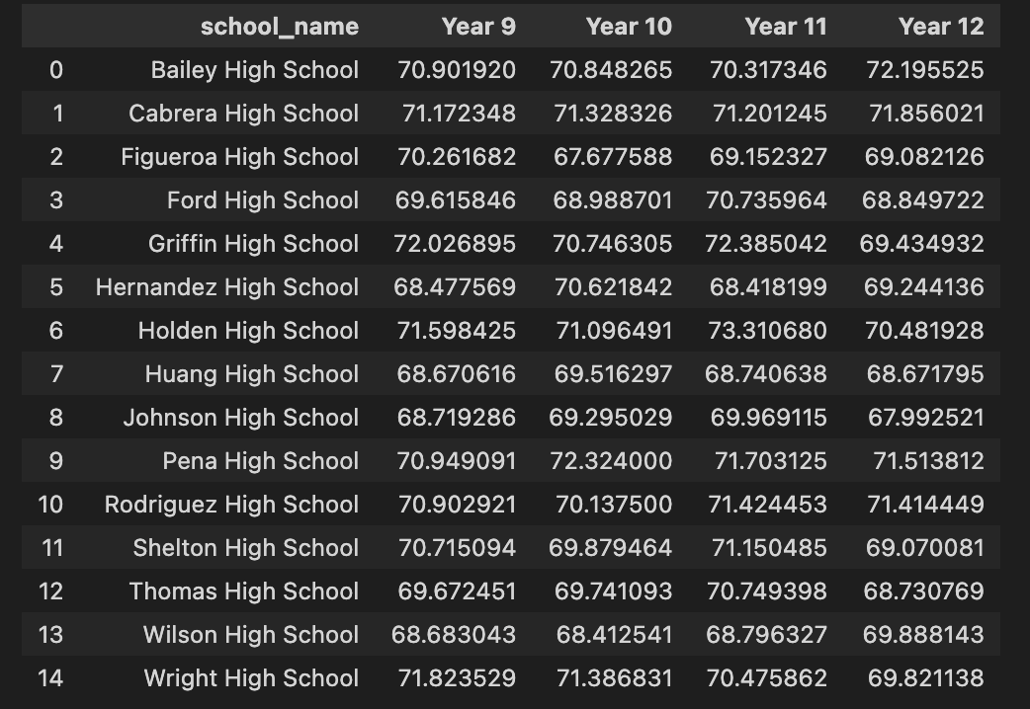
3.2
Reading Scores by Year

Slide 10
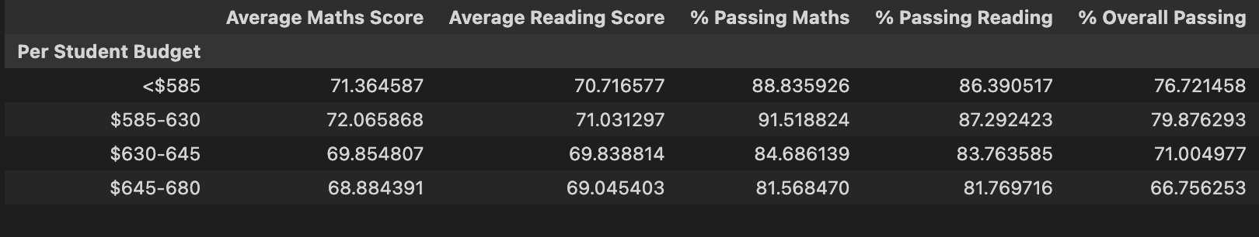
3.3
Scores by School Spending
Considering the relations between School spending and students scores,
when per Student budget is $585-630, students’ performance is best.

Slide 11
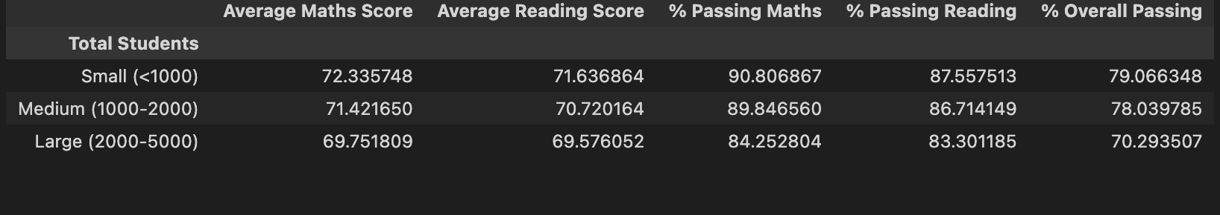
3.4
Scores by School Size
Considering the relations between School size and students scores,
when Total Student budget is less than 1000, students’ performance is best.

Slide 12
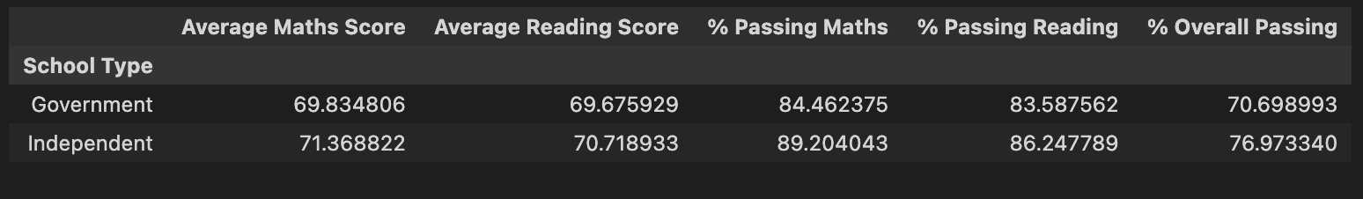
3.4
Scores by School Type
Based on the overall analysis, students studied in Independent Schools performed better than ones in Government Schools .

Slide 13
Thank You

